Slide 1
Introduction to the world of text mining
Using R and many helpful packages
Florian Gilberg
CorrelAidX Cologne

Slide 2
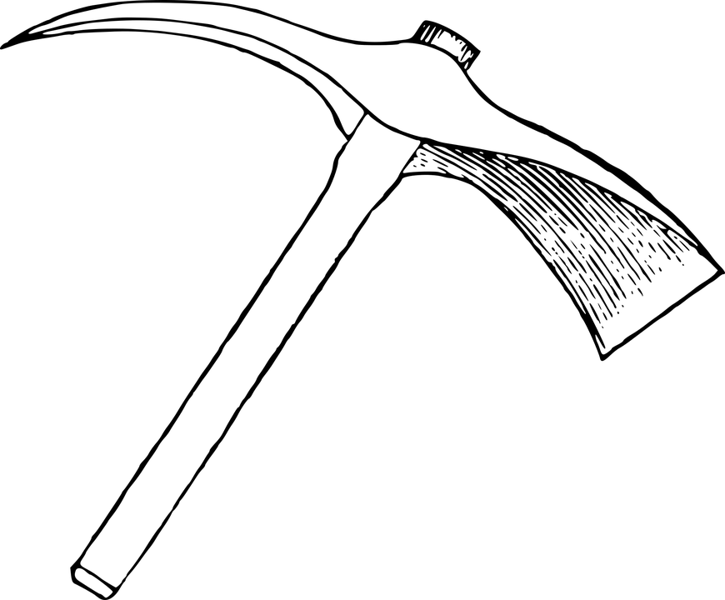
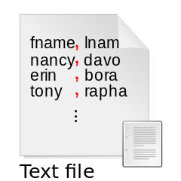
Text Mining - Get your pickaxe!
+
= ?

Slide 3
Text Mining - Key points
Transform free (unstructured) text into normalized, structured data
using various different Natural Language Processing (NLP) Tasks
to discover and reveal hidden patterns and information

Slide 4
Transform Text into Data

Slide 5


Text as Data-approach
The quick brown fox jumps over...
????????????????????????????????????
(Gentzkow et al. 2019)

Slide 6
How can we make text machine readable?
Machine Leaning
Complicated AI
Model training
Complex computing operations

Slide 7
Dictionaries.

Slide 8
Cleaning
Delete all frequently occurring “filling words” that (in most cases) don’t add any value for our analysis.
These are so called “stop words”. Stop words are collected in dictionaries.
In R, you can use pre-defined dictionaries, for example
tm::stopwords()
The quick brown fox jumps over the lazy dog

Slide 9
2. Stemming / Lemmatizing
stemming: chops off the ends of words in the hope of achieving this goal correctly most of the time
The quick brown fox jumps over the lazy dog.
lemmatizing: compares the word to a dictionary and returns the most likely candidate in its base form
The quick brown fox jumps over the lazy dog.
Reduce all remaining words to their “core” by chopping of the different different grammatical forms.
“Lemmata” or “Stems” can be used to improve uniformity and provide comparable data.
In R, you can lemmatize by using the TreeTagger in the udpipie-package or us the stemmer with tm::stemDocument()

Slide 10
3. Counting with the Bag-of-words approach
The quick brown fox jump over the lazy dog. | 0 1 1 1 1 1 0 1
Source

Slide 11
3. Counting with the Bag-of-words approach
 | The | quick | brown | fox | jumps | over | the | lazy
Maria | 0 | 0 | 0 | 0 | 0 | 0 | 0 | 0
jumps | 0 | 0 | 0 | 0 | 1 | 0 | 0 | 0
up | 0 | 0 | 0 | 0 | 0 | 0 | 0 | 0
quick | 0 | 1 | 0 | 0 | 0 | 0 | 0 | 0
as | 0 | 0 | 0 | 0 | 0 | 0 | 0 | 0
she | 0 | 0 | 0 | 0 | 0 | 0 | 0 | 0
disco-vers | 0 | 0 | 0 | 0 | 0 | 0 | 0 | 0
More info

Slide 12
Text as Data-approach
The quick brown fox jumps over...
1011010010110101001011001111001010110011
(Gentzkow et al. 2019)

Slide 13
Discover hidden patterns

Slide 14
Linguistic annotation
ADJ: adjective
ADP: adposition
ADV: adverb
AUX: auxiliary
CCONJ: coordinating conjunction
DET: determiner
INTJ: interjection
NOUN: noun
NUM: numeral
PART: particle
PRON: pronoun
PROPN: proper noun
PUNCT: punctuation
SCONJ: subordinating conjunction
SYM: symbol
VERB: verb
X: other
To find patterns in speech we can use machine learning models to tokenize and annotate our documents.
Popular packages and programs for this task are StanfordNLP, SpaCy, openNLP and udpipe.

Slide 15
Sentiment analysis
negative examples
Abbau|NN -0.058 Abbaus,Abbaues,Abbauen,Abbaue,Abbauten
Abbruch|NN -0.0048 Abbruches,Abbrüche,Abbruchs,Abbrüchen,Abbruche
Abdankung|NN -0.0048 Abdankungen
Abdämpfung|NN -0.0048 Abdämpfungen
Abfall|NN -0.0048 Abfalles,Abfälle,Abfalls,Abfällen,Abfalle
Abfuhr|NN -0.3367 Abfuhren
Abgrund|NN -0.3465 Abgründe,Abgrunde,Abgrundes,Abgrunds,Abgründen
Abhängigkeit|NN -0.3653 Abhängigkeiten
positive examples
Freude|NN 0.6502 Freuden
Freund|NN 0.0116 Freunden,Freundes,Freunde,Freunds
Freundlichkeit|NN 0.0913 Freundlichkeiten
Freundschaft|NN 0.2059 Freundschaften
Frieden|NN 0.0040 Friedens
Fruchtbarkeit|NN 0.0040
Funktionsfähigkeit|NN 0.0040 Funktionsfähigkeiten
Furchtlosigkeit|NN 0.0040
Discover positive and negative words or even emotions by using weighted dictionaries.
IGGSA

Slide 16
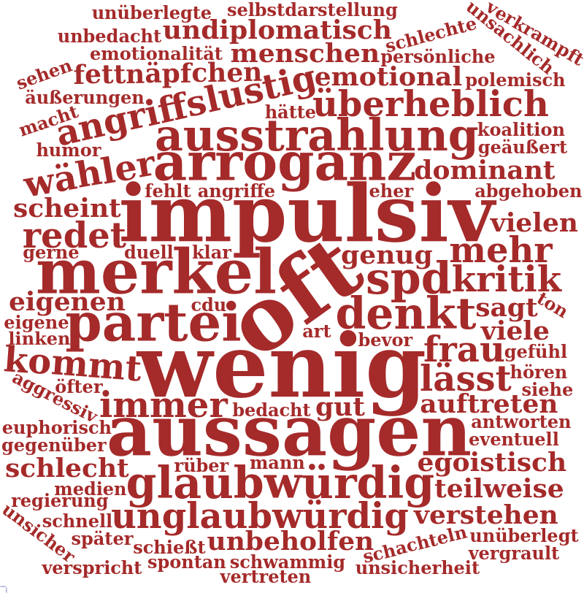
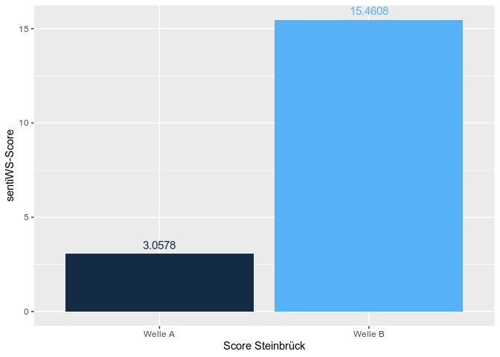
Sentiment analysis
Discover positive and negative words or even emotions by using weighted dictionaries.
IGGSA

Slide 17
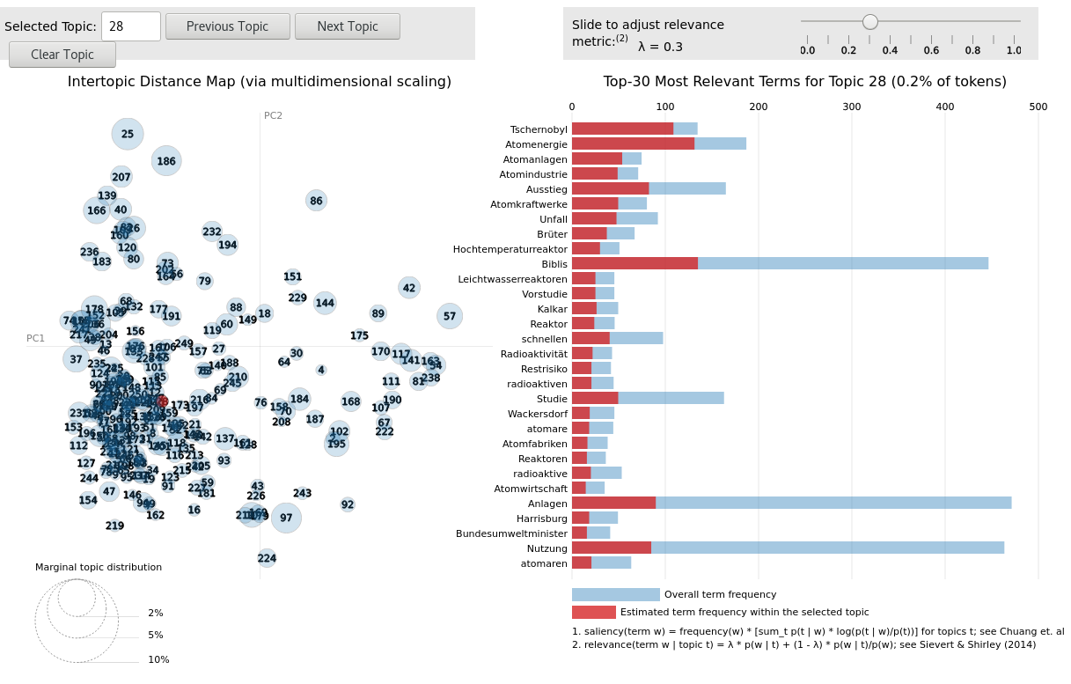
Topic modelling
Trying to represent similarities in word occurrence by assigning them the same topic number.
Good introduction

Slide 18
And so much more...

Slide 19
